Slide 1
Computational Techniques in Bioinformatics and Biomedical Data Analysis
Shaopeng Gu
Department of Mathematics & Statistics
South Dakota State University
May 20th 2019
Notes:
Good morning. My name is Shaopeng Gu, a graduate student in Department of mathematics and statistics from South Dakota State University. First of all, I would like to thank you all for offering me such a good opptunity to have this presentation in the Ohio State University. Today, I plan to give a 30 minitues presentation and 15 minutes for answering qustiosn. But you are welcome to stop me during the talk if you have any questions. The topic of my presentation is Computational techniques in bioinformatics and biomedical data analysis.

Slide 2
OUTLINES
Self-introduction
Skills
Research projects
Notes:
At beginning of this presentation, I will introduce my education and working background. After that, I will take some time to show my skills and I believe that will be a reason why I will able to handle this postion. Some of my research project will be introduced, particulary about using computation methods to analyze the bioinformatics and biomedical data to support my strength and ability.

Slide 3
SELF-INTRODUCTION Background
Organic Electronic Lab
Dr. Qiquan Qiao
Department of Electrical Engineering and Computer Science
Dr. Zhen Ni
Bioinformatics and Mathematical Biosciences Lab
Dr. Qin Ma
Undergraduate study in Electronic Engineering, SDSU
Graduate study in Mathematics and Statistics, SDSU
Graduation in the summer of 2019
2012
2017
2019
2016
2018
Critical Thinking & Coding
Bioinformatics & Big data
2013
Machine Learning
Statistical Modeling
Department of Mathematics and Statistics
Dr. Xijin Ge
2017
2019
Notes:
I have been in this country since 2011. From 2012 to 2017, I studied Electrical Engineering in South Dakota State University. After that, I continued my education there as a master student, but switched my major from EE to Statistics. I plan to graudate in next month. My first job was a part-time research Assistant in Dr. Qiquan Qiao’s organic Electronic Lab during my bachelor’s period. My main duty there is to farbricate organic solar cells, collect their performace data, plot current voltage curves and calucate the solar cells’ performacne. This job guide me to the research area. I learned a lot about how to read papers, collbrate with other PHD students, critical thinking and manage my schedules and most importantly: improve my coding skills. During my master period, I was a research assistant in Department of Electrical Engineering and Computer science. I accumulated a lot of machine learning knowledge from this postion includes popular supervised and unsupervised machine learning methods. For applying my machine learning methods, I joined Dr. Qin Ma’s bioinformatics and mathmetical bioscience lab. This experience help me to access the bioinformatics area, particularly about sequencing data and biomedcial data analysis. I also learned how to use computer clusters to play with big data. From Jan of 2019, I joined Xijin Ge’s lab in Department of mathematical and Statistics, Dr. Xijie Ge is also my academic adivsor for staticsics. I learned a lot of staticics algrotihms includes chi2, factor analysis and statiscal modeling knowledge from him.

Slide 4
SELF-INTRODUCTION Publications
[2019] Zhao Jing, Shaopeng Gu, Adam McDermaid. Predicting outcomes of chronic kidney disease from EMR data based on Random Forest Regression. Mathematical Biosciences .
[2019] Russel Wilke, Mohammad Qamar, Roxana Lupu, Shaopeng Gu, Jing Zhao, Chronic Kidney Disease in Agricultural Communities. The American Journal of Medicine.
[2018] Adam McDermaid, Xin Chen, Yiran Zhang, Cankun Wang, Shaopeng Gu, Juan Xie, Qin Ma, A new machine learning-based framework for mapping uncertainty analysis in RNA-Seq read alignment and gene expression estimation. Frontiers in Genetics.
[2016] Ashish Dubey, Nirmal Adhikari, Swaminathan Venkatesan, Shaopeng Gu, Devendra Khatiwada, Qi Wang, Lal Mohammad, Mukesh Kumar, Qiquan Qiao*, Solution processed pristine PDPP3T polymer as hole transport layer for efficient perovskite solar cells with slower degradation. Solar Energy Materials and Solar Cells.
[2016] Ashish Dubey, Nirmal Adhikari, Swaminathan Venkatesan, Shaopeng Gu, Devendra Khatiwada, Qi Wang, Lal Mohammad, Mukesh Kumar, Qiquan Qiao*, Shelf life stability comparison in air for solution processed pristine PDPP3T polymer and doped spiro-OMeTAD as hole transport layer for perovskite solar cell. Data in Brief.
[2016] Nirmal Adhikari, Ashish Dubey, Eman A. Gaml, Bjorn Vaagensmith, Khan Mamun Reza, Sally Adel Abdelsalam Mabrouk, Shaopeng Gu, Jiantao Zai*, Xuefeng Qian*, Qiquan Qiao*, Crystallization of Perovskite Film for Higher Performance Solar Cells by Controlling Water Concentration in Methyl Ammonium Iodide Precursor Solution. Nanoscale.
Notes:
During my five years’ total research expreiences, I publushed six papers. The first three is published during my master period and last three in bachelor’s period. Most of my research adivosor and collbraotors value me as a hard-working and productive students. In addition, I am good at work with others as a team. I have collbratroed with many great researchers from different institutions.

Slide 5
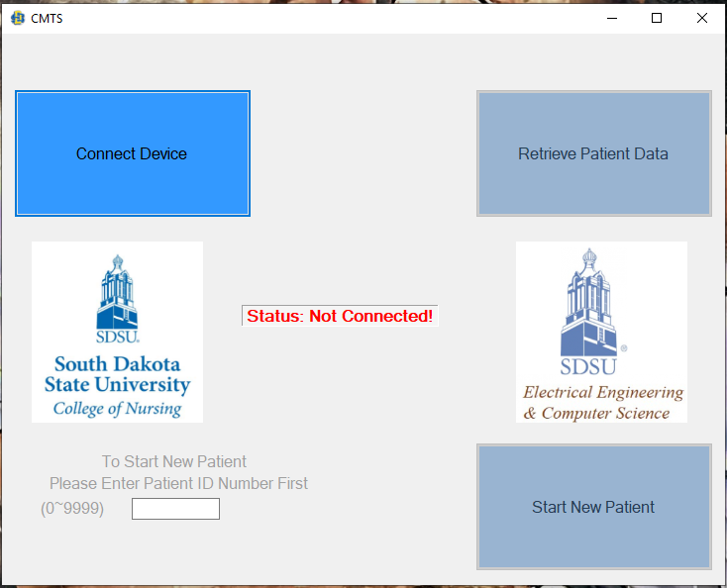
Skills
Strong coding experience in multiple languages
Python, R, Perl, MATLAB, C++
Strong Machine learning knowledge
Supervised: SVM, KNN, Elastic-Net, RandomForest, etc.
Unsupervised: K-means, mixture models, t-SNE, UMAP, etc.
Packages: Sklearn, Tensorflow, Numpy, Pandas, Matplotlib, Scipy, etc.
Strong experience in sequencing data analysis
1T scRNA-seq and 3T bulk RNA-seq data analysis experience
Fastqc, HTseq, Hisat2, STAR, Bowtie2, Ballgown, Deseq2
Seurat, Monocle, SC3, CellRanger, SCENIC, MAST
Strong experience in computer cluster
XSEDE (Founded by NSF, server located in Pittsburgh Supercomputing Center)
CyVerse
SDSU cluster: blackjacks
Notes:
During many years’ work experience, I acculated a lot of knowleges and skills. Frist of all, I had strong coding experience using different programming languages. I am proficient at Python, R and perl. Python is cullently popular programing lanugage because it is powerful and fast for machine learning. I developed three python tools for my research projects. R is another popular lanuage which is suited for statical computing and graphs and I manily used R for staticscal modeling. Perl is good for data mining because it is easy to extract information from sequencing data at different levels. During my undergrauate period, I mainly used C++ and Matlab. For my senior design project, I used C++ to develop a windows software for SDSU, college of nursing, which can retreive timestamp data using USB communication methods from a cortisol measurement timestap device. With this software and our device, patients do not need spend two days in a medecal center to collect cortisol. They do cortisol measurment at home and the device will mointor their the what time they do the meareuemnt. I am also well trained in machine learning. I applied a lot of machine learning methods for my research projects includes some supervised methods, SVM, KNN, Elastic-Net, RandomForest and many others. I am also capable for unspervised learning methods such as Kmeans, mixture models, TSNE. Tsne is well suited for viluallzation for high diminonal data. It can be applied for imiage processing, genomic data and natural language processing. Tsne maps the multi-diminsonal data to a lower diminson space and try to find patterns by identifying the observed clusters. Most of signle-cell pipeline includes this technique. I recently heard new diminsonl reduction method called UMAP. It is similar to tsne but a recent publications show is has faster running time and can generate meaningfull organization for cell type. Machine learning is still growing and I can expected that there will have more advanced methods in the future. I am always eargr to learn them.
I analyzed more than 1T scRNA-seq and 3T bulk RNA-seq data of plant and animial species. I am faimilar with follwing popular tools: fastqc for quality control, Htseq for feature counts, Hisat2, STAR, Botiew2 for read alignment, DESEQ2 and Bollgown for differential expresiion analysis.

Slide 6
WHY NEED COMPUTATIONAL METHODS?
Gaps exist between sequencing data and their functional annotations, e.g.:
Number of protein sequencing (NCBI) reached 171,418,145 (by 2018)
Number of well-annotated sequences (Swiss-Prot) is only 557,491 (by 2018)
Study of sequence features is important for:
Bioinformatics and biomedical researches
Drug target development
Computational methods are urgently needed, because:
Human can not discern
Wet laboratory experiment are costly

Slide 7
RESEARCH PROJECTS
Predicting outcomes of chronic kidney disease from Electronic medical records (EMR) data
A feature extraction and selection Python tool for sequencing data
Single-cell RNA-seq data analysis
A new Machine learning-based framework for mapping uncertainty analysis in RNA-seq read alignment and gene expression estimation
Notes:
Therefore, my main research interests is to develop computational tools to help researchers to understand bioinformatics and biomedical data better.

Slide 8
PREDICTING OUTCOMES OF CKD FROM EMR DATA
Stage of chronic kidney disease (CKD) is defined by estimated glomerular filtration rate (eGFR)
CKD can be predicted if future eGFR can be accurately estimated
Early identification of CKD have potential to
Reduce number of patients progressing to End Stage Renal Disease
Lower mortality rate and healthcare costs
Predicting models were built by data extracted from a regional health system, Sanford
120,495 patients aged from 20 to 80 in Sioux Falls, SD

Slide 9
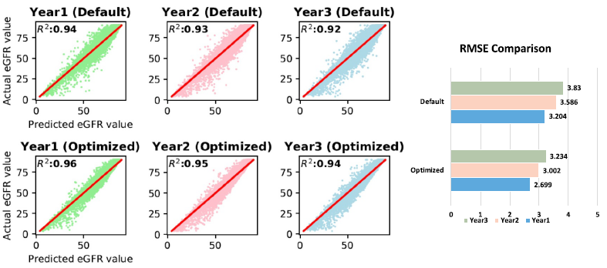

PREDICTION RESULTS
eGFR prediction is evaluated by $R^{2}$ and Root of Mean Squared Error

Slide 10
RESEARCH PROJECTS
Predicting outcomes of chronic kidney disease from Electronic medical records (EMR) data
A feature extraction and selection Python tool for sequencing data
Single-cell RNA-seq data analysis
A new Machine learning-based framework for mapping uncertainty analysis in RNA-seq read alignment and gene expression estimation
Notes:
Therefore, my main research interests is to develop computational tools to help researchers to understand bioinformatics and biomedical data better.

Slide 11
A FEATURE EXTRACTION AND SELECTION PYTHON TOOL FOR SEQUENCING DATA
Extraction: Transforming sequences into mathematical expression (descriptors)
Represent sequences
Predict structural and functional classes, fold recognition, protein-protein interaction, etc.
Selection: Selecting those features which contribute most to the prediction is necessary
Time and memory consuming
Poor prediction due to noisy features and overfitting
Notes:
the AAindex database contains 544 physicochemical properties for each amino acid.

Slide 12
OVERVIEW OF TOOL
LABEL
Data
Feature Extraction
42 types of descriptors
Unsupervised method
8 methods
Supervised Selection
17 methods
Performance Evaluation
6 methods
Output
DNA
kmer
DAC
TAC
10
more
PCA
CHI2
Random Forest
Selected Feature Vectors
LLE
LASSO
KNN
DR
Results
Vectors
RNA
kmer
DAC
DCC
6
more
SVD
ReliefF
SVM
DAC
ACC & ROC
Results
Factor Analysis
Mutual Information
Neural
Network
Protein
AAC
PAAC
DPC
17
more
Best model selection
4 more
13 more
2 more

Slide 13
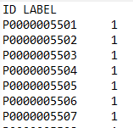
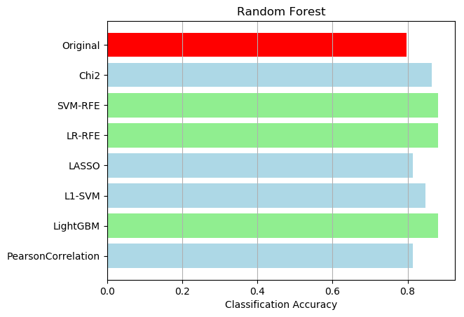
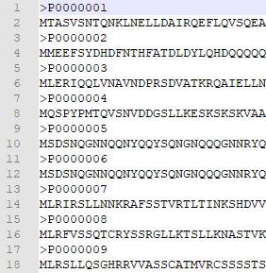
APPLICATION
Predicting whether a protein is contained in chloroplast
Feature
Extraction
(AAC)
Feature
Selection

Slide 14
RESEARCH PROJECTS
Predicting outcomes of chronic kidney disease from Electronic medical records (EMR) data
A feature extraction and selection Python tool for sequencing data
Single-cell RNA-seq data analysis
A new Machine learning-based framework for mapping uncertainty analysis in RNA-seq read alignment and gene expression estimation
Notes:
Therefore, my main research interests is to develop computational tools to help researchers to understand bioinformatics and biomedical data better.

Slide 15
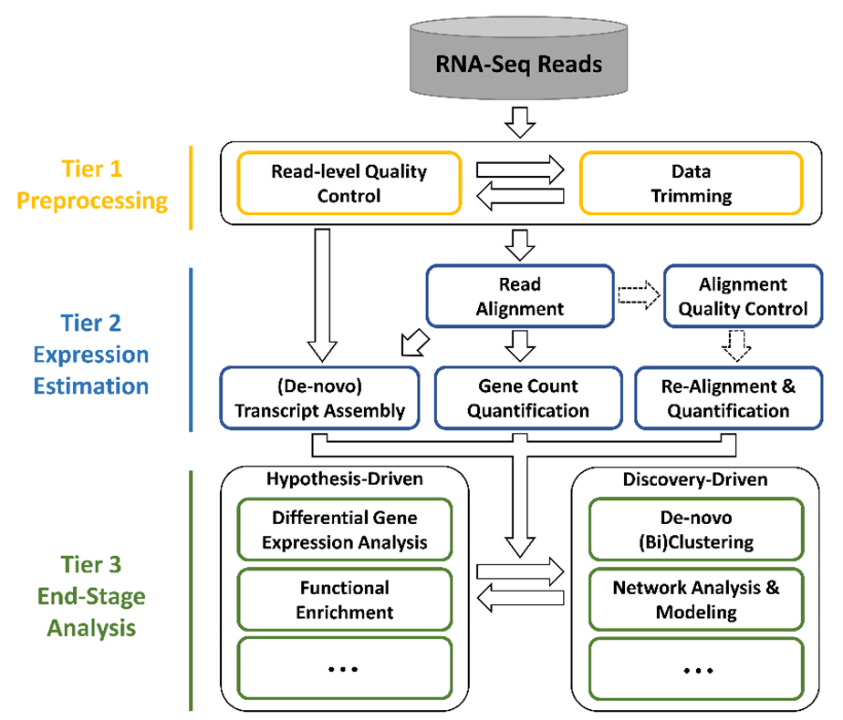
SINGLE-CELL RNA-SEQ ANALYSIS
Single cellular resolution
Recognize cell heterogeneity
Issue – dropouts (highly sparse)
Major research areas:
Cell type prediction
Cell trajectory analysis
Psudotime
Spatial position identification
Hierarchy structure
Cell type specific regulatory network
etc…
Notes:
Recent advances in analyzing tissues and organs at the single cell level are revolutionizing our understanding of organ development, biology, and disease. The traditional bulk RNA-seq loses information on the heterogeneity of individual cells. scRNA-Seq from individual cells preserves heterogeneity, and technological advances have made these techniques highly accessible. They are now utilized in a significant percentage of biological studies to report finding such as more precise quantifications of cell composition, the discovery of previously unknown or rare cell subtypes, and highly detailed descriptions of cell fate trajectories.
Due to the limitation of sequencing techniques, one critical issue of scRNA-seq analysis is the dropout, meaning that large quantity of zeros exist. The highly sparse expression data makes the analysis similar but also differ than the traditional bulk RNA-seq data, and so that, many tools and pipelines have been developed specifically designed for scRNA-Seq data analysis, such as Seurat, Monocle, SC3, etc.
In general, the three steps are included in a scRNA-seq analysis pipeline: mapping alignment, preprocessing, and advanced analyses. The first step is similar to bulk RNA-seq analysis, some bulk tools are even compatible for single-cell analysis, such as STAR and bowtie2. Preprocessing step treats the expression matrix by filtering low-quality genes and cells and normalizing expression values by some distributions. Currently, the cutting-edge researches of scRNA-seq analysis focus on the following areas: Cell type prediction, Cell trajectory analysis, Psudotime, Spatial position identification, Hierarchy structure, Cell type specific regulatory network, and etc…

Slide 16
CELL TYPE PREDICTION FROM scRNA-seq
Comparing the accuracy and goodness in predicting cell types among six existing pipelines/tools.
Data: 15 scRNA-Seq datasets with cells ranging from 49 to 3005 and genes from 10,000 to 40,000. Including two 10X data and 1 smart-seq data.
Tools: SC3, SCENIC, Seurat, Monocle, BackSPIN, Sincera
Result: Seurat is the most powerful tool (multifunctional) with highest prediction scores (adjusted rand index)
Notes:
One of my collaborative project was to use different scRNA-Seq analytical tools to test the their cell type prediction. I helped the team by learning and testing six single-cell integrative tools including SC3, SCENIC, Seurat, Monocle, BackSPIN, and Sincera.
(把ppt上的念一念就行了)

Slide 17
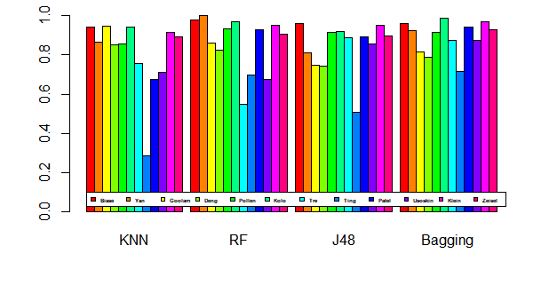
CELL TYPE CLASSIFICATION FROM scRNA-seq
Also tested four supervised machine learning methods
TP rate of four classification methods based on expression data
Notes:
I also have tested four supervised machine learning methods, KNN, Random forest, J48, and bagging, for their clustering performance in cell type identification. The test showed that in general, Bagging method performs better that the other three. Also, the difference among datasets is huge, such as number of cells, complexity of cell types, dropout percentage so that it is hard to find a robust method that can have good clustering performance for any dataset.

Slide 18
RESEARCH PROJECTS
Predicting outcomes of chronic kidney disease from Electronic medical records (EMR) data
A feature extraction and selection Python tool for sequencing data
Single-cell RNA-seq data analysis
A new Machine learning-based framework for mapping uncertainty analysis in RNA-seq read alignment and gene expression estimation
Notes:
Therefore, my main research interests is to develop computational tools to help researchers to understand bioinformatics and biomedical data better.

Slide 19
GENEQC
A machine learning-based tool for mapping uncertainty analysis and gene expression estimation
Notes:
Most RNA-seq studies perform read alignment without much concern for the quality of the alignment results, assuming them to be of sufficient quality. However, our investigation has shown that mapping uncertainty is a prominent issue with the quality of alignment results. We tested 95 datasets the total size about 2T. Each dataset was aligned using HISAT2, against the appropriate reference genome. Alignment statistics were collected or calculated from the HISAT2 output file. It was determined that an average of 22% of all reads were ambiguously aligned in each of the seven distinct plant and animal species. Just as most RNA-seq pipelines use some quality control method for raw reads, a quality control process for read alignment must be included to verify the reliability of mapping results. Therefore, we developed this alignment control tools. In GeneQC, we extract usable features from two genetic levels, genomic and transcriptomic. These three levels of information are combined using linear modeling to develop a distinct score, referred to as the D-score, to provide a clear measure of the level of mapping uncertainty for each annotated gene for a particular species. Additionally, mixture model distributions are used to determine categorizations for the mapping uncertainty and provide recommendations for which genetic expression estimates are reliable following the read alignment step.

Slide 20
ACKNOWLEDGEMENT
Researcher | Title | Institution/Company
Dr. Qiquan Qiao | Professor | South Dakota State University
Dr. Ashish Dubey | Analyst & Engineer | Daktronics
Dr. Zhen Ni | Assistant Professor | South Dakota State University
Dr. Qin Ma | Associate Professor | The Ohio State University
Dr. Adam McDermaid | Computational Medical Informatics Analyst | Sanford Health
Dr. Bin Yu | Associate Professor | Qingdao University of Science & Technology, China
Dr. Sen Subramanian | Associate Professor | South Dakota State University
Dr. Xijin Ge | Associate Professor | South Dakota State University
Dr. Russell Wilke | Dean of Medical School | University of South Dakota

Slide 21
THANK YOU!

